Slide 1
INTRODUCTION TO HTML
Instructor : Engr. Ayesha Khan

Slide 2
Marking Scheme
EVALUATION INSTRUMENTS | MARKS
LAB ASSESMENT | 30
ASSIGNMENTS | 10
LAB FILE | 20
PROJECT | 30
LAB VIVA | 10
TOTAL | 100

Slide 3
WHAT IS HTML?
HTML is the standard markup language for creating Web pages.
HTML stands for Hyper Text Markup Language
HTML describes the structure of a Web page
HTML consists of a series of elements
HTML elements tell the browser how to display the content
HTML elements are represented by tags
HTML tags label pieces of content such as "heading", "paragraph", "table", and so on
Browsers do not display the HTML tags, but use them to render the content of the page

Slide 4
Tags in HTML
The <!DOCTYPE html> declaration defines this document to be HTML5
The <html> element is the root element of an HTML page
The <head> element contains meta information about the document
The <title> element specifies a title for the document
The <body> element contains the visible page content
The <h1> element defines a large heading
The <p> element defines a paragraph

Slide 5
Links
HTML links are defined with the <a> tag:
<a href="https://www.w3schools.com">This is a link</a>

Slide 6
HTML Images
HTML images are defined with the <img> tag.
The source file (src), alternative text (alt), width, and height are provided as attributes:
<img src="w3schools.jpg" alt="W3Schools.com" width="104" height="142">

Slide 7
HTML Lists
HTML lists are defined with the <ul> (unordered/bullet list) or the <ol> (ordered/numbered list) tag, followed by <li> tags (list items)

Slide 8
Headings
Headings are defined with the <h1> to <h6> tags.
<h1> defines the most important heading. <h6> defines the least important heading.

Slide 9
HTML Line Breaks
The HTML <br> element defines a line break.
Use <br> if you want a line break (a new line) without starting a new paragraph

Slide 10
HTML Formatting Elements
Formatting elements were designed to display special types of text:
<b> - Bold text
<strong> - Important text
<i> - Italic text
<em> - Emphasized text
<mark> - Marked text
<small> - Small text
<del> - Deleted text
<ins> - Inserted text
<sub> - Subscript text
<sup> - Superscript text

Slide 11
HTML5
The most interesting new HTML5 elements are:
New semantic elements like <header>, <footer>, <article>, and <section>.
New attributes of form elements like number, date, time, calendar, and range.
New graphic elements: <svg> and <canvas>.
New multimedia elements: <audio> and <video>.

Slide 12
HTML5 Document
The following tags have been introduced for better structure −
section − This tag represents a generic document or application section. It can be used together with h1-h6 to indicate the document structure.
article − This tag represents an independent piece of content of a document, such as a blog entry or newspaper article.
aside − This tag represents a piece of content that is only slightly related to the rest of the page.
header − This tag represents the header of a section.
footer − This tag represents a footer for a section and can contain information about the author, copyright information, et cetera.
nav − This tag represents a section of the document intended for navigation.
dialog − This tag can be used to mark up a conversation.
figure − This tag can be used to associate a caption together with some embedded content, such as a graphic or video.

Slide 13
Html Lists
The LIST Element
These are:
<UL> is used to list item without specific order
<OL> is used to list item with specific order
<DL> definition list
<DT> define a term in description list
<DD> describe the term in a description list
<LI> is used to identify the items of list and used within <UL></UL>tags

Slide 14
Html Lists
The LIST Element type
Type | Description
Type=“1” | The list items will be numbered with numbers (default)
Type=“A” | The list items will be numbered with uppercase letters
Type=“a” | The list items will be numbered with lowercase letters
Type=“I” | The list items will be numbered with uppercase roman numbers
Type=“i” | The list items will be numbered with lowercase roman numbers

Slide 15
Html Lists
The LIST Element Marker
Marker | Description
Disc | Sets the list item marker to a bullet (default)
Circle | Sets the list item marker to a circle
Square | Sets the list item marker to a square
None | The list items will not be marked

Slide 16
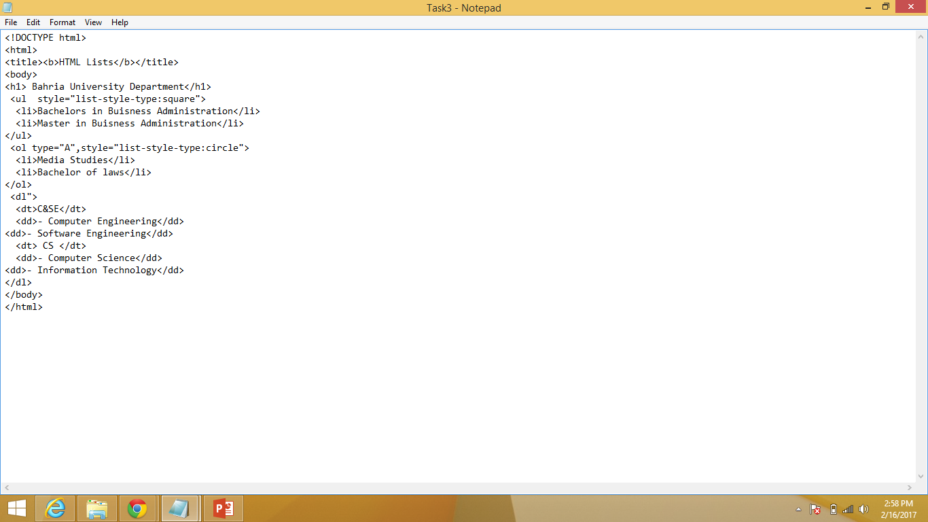
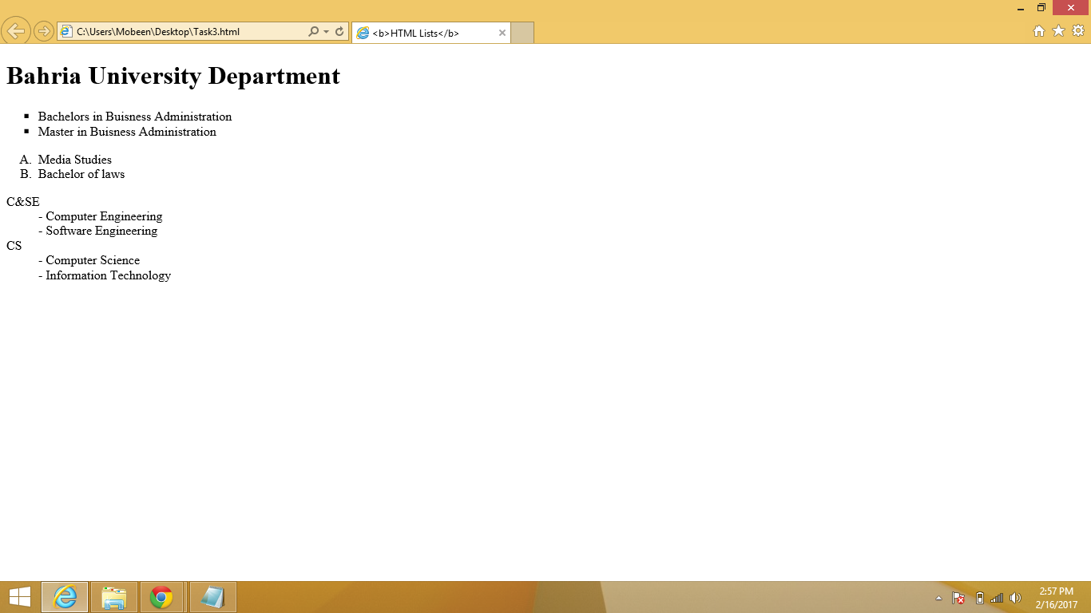
Html Lists

Slide 17
Html Tables
The Table Element
Tables can be used for more than just displaying a table of data. Tables can also be used as formatting tool. The data in a table can be text or images.
The <TABLE> element lets the browser know that a table follows. The attributes to the <table> element apply to the table itself not the data displayed in the table.

Slide 18
Html Tables
Attributes
Align—This attribute specifies the alignment of the table.
Width—This attribute specifies the width of the table, not columns.
Border—The border attribute specifies that the border of the table should be drawn.
Cellspacing—This attribute specifies the spacing between cells
Cellpadding—This attribute specifies padding within cells.

Slide 19
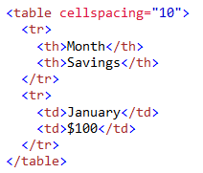
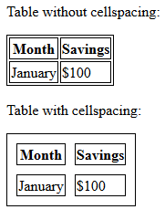
Html Tables
Cell Spacing
Example:

Slide 20
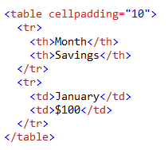
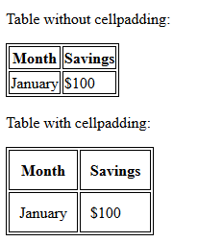
Html Tables
CELL PADDING
Example:

Slide 21
Html Tables
CELL PADDING
Example:

Slide 22
Html Tables
Table Elements
The <TR> (TABLE ROW) Element
The <TR> is for defining table rows. Inside the <TR> element is found the table header and table data element.
The <TH> (TABLE HEADER) and <TD> (TABLE DATA)
The <TH> and <TD> are the table cell element. They identify the data to be displayed in the table. Each occurrence of <TH> or <TD> within a table row (<TR>) defines a new column
Attribute
Align—this attribute is used to define the left\right alignment for data displayed in the column.

Slide 23
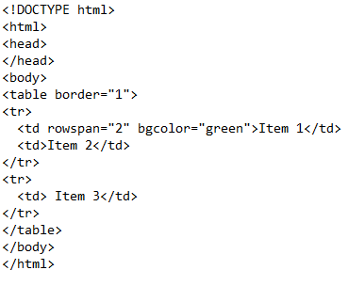

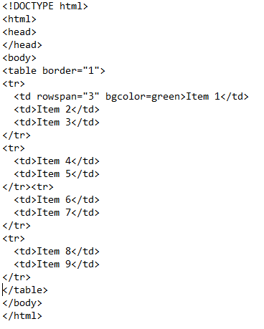
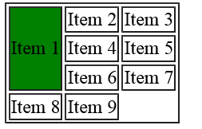
Html Tables
ROWSPAN
Example # 1
Example # 2

Slide 24
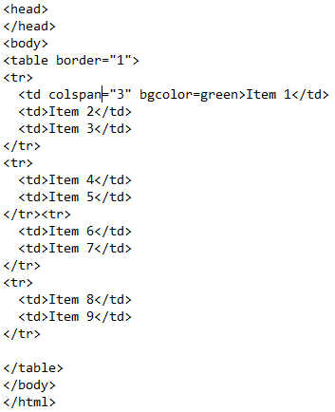
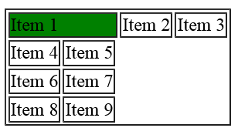
Html Tables
COLSPAN
Example:

Slide 25
Forms
Form elements are different types of input elements, like text fields, checkboxes, radio buttons, submit buttons
Input Form
Type | Description
Text | One line text input field
Radio | Define radio button for selecting one of many choices
Submit | Define a submit button for submitting a form

Slide 26
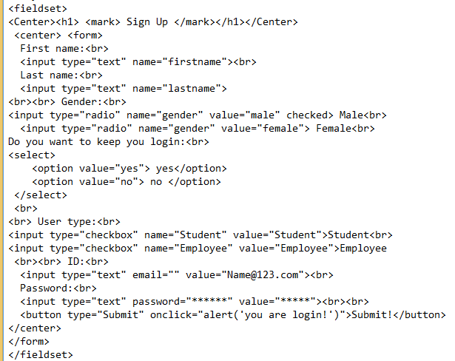
Forms

Slide 27
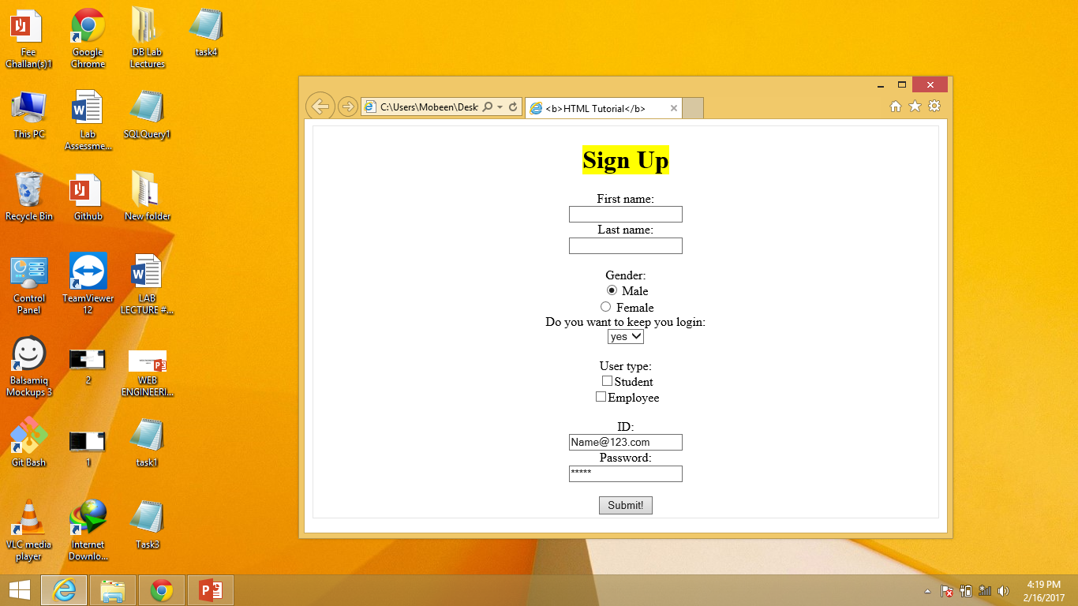
Forms

Slide 28
LAB TASKS
Make a 5 page website, including home page, linked altogether having header and footer section mandatorily. Web pages should cover all the html tags overall eg : make a gallery page with the help of table tag and insert images in that.
Topic for the website can be anything. No css required.
Make sure to use all tags mentioned in slides.

